Slide 1







ROMARINOVA
From Tunisian Rosemary Chemotypes to Evidence-Guided Candidate Prioritization for α-Glucosidase Inhibition
EthnoHack 2026
Track: Natural Products for Drug Discovery
INSTITUTION
SCIENTIFIC FIELD
TEAM MEMBERS
HIGHER INSTITUTE OF MEDICAL TECHNOLOGIES OF TUNIS (ISTMT)
(UTM)
BIOTECHNOLOGY ENGINEERING
SPECIALIZATION IN BIOPHARMACEUTICAL ENGINEERING
IMEN MELLOULI
AYMEN LAHDHIRI
HANINE MNASRI
A candidate-prioritization and traceability platform — not a claim that rosemary cures diabetes

Slide 2












From Traditional Medical Knowledge to Data-Driven Drug Discovery
The main challenge is not simply identifying bioactive compounds, but connecting botanical identity, chemical composition and biological evidence through a traceable and reproducible workflow.
FRAGMENTED SOURCES
INTEGRATED SCIENTIFIC PRIORITIZATION
THE CHALLENGE
  Critical knowledge is
fragmented across
disconnected sources
LITERATURE
REPORTS
01
Variety-level traceability
botanical identity to data
ROMARINOVA
scattered publications
one traceable platform connecting identity, chemistry, activity,
and predictions
to
accelerating discovery with traceability and confidence Interactive visualization
02
Compound identification
and chemical annotation
  Botanical identity, chemistry, and bioactivity are rarely linked at the variety level
CHEMICAL
DATA
03
Machine learning
screening and prediction
compound information across datasets
04
Molecular docking
target interaction modeling
  Predictions exist in isolation, not in a traceable workflow
BIOACTIVITY
DATA
05
Similarity analysis
across compounds and targets
assays and results
in multiple databases
06
visualization
explore, compare, prioritize
TYPE 2 DIABETES PROVIDES THE BIOMEDICAL CONTEXT OF OUR RESEARCH, PARTICULARLY THROUGH THE INVOLVEMENT OF BIOLOGICAL TARGETS ALPHA-GLUCOSIDASE, AN ENZYME ASSOCIATED WITH CARBOHYDRATE DIGESTION AND POSTPRANDIAL GLUCOSE REGULATION.

Slide 3


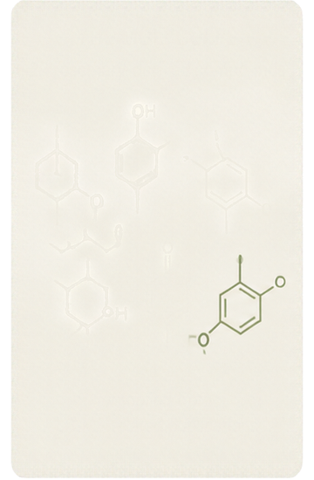


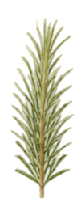
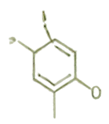
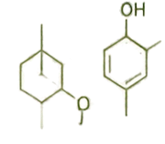
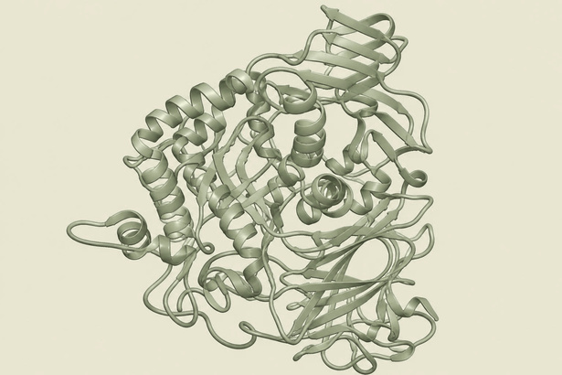



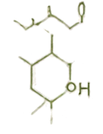

Connecting Tunisian Rosemary Chemistry to a Human Enzyme Target
From plant chemotypes to computational investigation of potential inhibition
THE PLANT & BIODIVERSITY
THE MOLECULES
THE TARGET
human alpha-glucosidase
(MGAM)
THE INVESTIGATION
28 rosemary-derived compounds
Tunisian Rosemary Diversity
- Geographic mapping of documented populations
- Two botanical varieties:
Salvia rosmarinus var. typicus
-Salvia rosmarinus var. & troglodytorum
Major reported chemotypes
1,8-cineole | Camphor | α-pinene
computational evaluation of potential inhibition by rosemary compounds
Computational predictions require experimental and clinical validation
role in carbohydrate digestion
and postprandial glucose regulation
compiled from
LC-MS-related publications

Slide 4

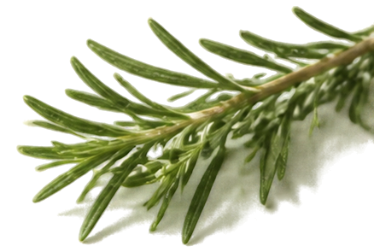



























Building a Traceable and Reproducible Scientific Dataset
DATA SOURCES
DATA PIPELINE
rosemary chemical
dataset
28 compounds
literature-linked,
molecular identifiers
data
collection
cleaning
molecular standardization
fingerprint
generation
dataset
preparation
model training
and evaluation
DOCUMENT-LEVEL SEPARATION WAS USED TO REDUCE PUBLICATION-RELATED DATA LEAKAGE
ChEMBL bioactivity
dataset
DOCUMENT-AWARE SPLIT
179 eligible records:
31 active, 148 inactive
TRAINING SET
zero
shared
documents
VALIDATION SET
zero
shared
documents
TEST SET
documents A–K
documents L–N
documents O–R
separation by document identifiers
PREVENT INFORMATION LEAKAGE BETWEEN TRAINING, VALIDATION AND TEST SETS BY SEPARATING RECORDS ACCORDING TO THEIR SOURCE DOCUMENTS

Slide 5










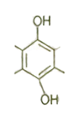

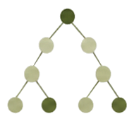
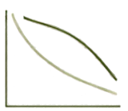




Predictive Screening of
Bioactive-Like Molecular Structures
MODEL PERFORMANCE (TESTSET)
HOW THE MODEL WORKS
HONESTY CHECK
0.781
1. REPRESENTATION
2. MODEL
3. EVALUATION
only 7 active compounds
in the test set
+0.046
ECFPA FINGERPRINTS
RANDOM FOREST CLASSIFICATION
PR-AUC ON
TEST SET
improvement
0.735
preliminary prioritization signal, not proof of generalization
Proteien
performance on this evaluation set does not guarantee applicability to new rosemary compounds
Random Forest Model (0.781)
Random Forest Model
Similarity-Only Baseline
molecular structures are converted into ECFP4
fingerprintss capturing
local chemical patterns
ensemble of 100 trees
with maximum depth 5
votes to classify
bioactive-like compounds
Similarity-Only Baseline (0.735)
modest improvement over similarity-only baseline
test PR-AUC
test PR-AUC
performance measured on an independent evaluation dataset
higher is better
a small but meaningful lift in predictive performance — interpret with caution, prioritize for validation

Slide 6

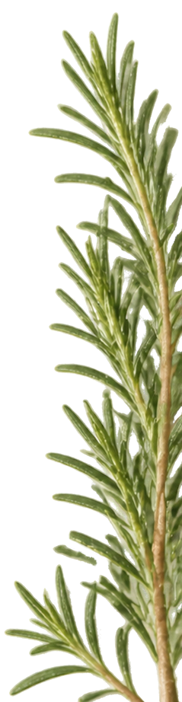
























An Integrated Consensus Strategy for Candidate Prioritization
FIVE WEIGHTED COMPONENTS
TOP FIVE DOCKING SCORES (KCAL/MOL)
CONSENSUS SCORE
0.30
ML screening signal
p-Cymene
-4.28
machine learning predicted activity
100%
gamma-Terpinene
0.20
Molecular similarity support
-4.30
structural similarity to known actives
one integrated score guides prioritization
Development feasibility
alpha-Phellandrene
-3.81
0.20
developability and ADMET potential
0.10
Novelty contribution
Linalool
-3.34
chemical novelty and uniqueness
FINAL_SCORE = 30% · ML RANKING + 20% · SIMILARITY + 20% · DEVELOPABILITY + 10% · NOVELTY + 20% · DOCKING
0.20
Predicted interaction score
Myrcene
-3.03
docking-based binding potential
DIAGNOSTICS HOLD
carnosol and carnosic acid are excluded from the main shortlist due to PAINS filters and severe steric clashes (+30 to +37 kcal/mol)
carnosol
carnosic acid
docking scores are computational estimates, not measured affinities

Slide 7






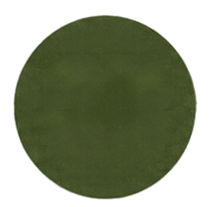




When the Model Becomes Silent
A scientific transparency test in extrapolation
FIVE-COMPONENT CONSENSUS RANKING (WITH ML WEIGHT)
ML-INDEPENDENT RANKING
(ML WEIGHT REMOVED)
1. Rosmarinic acid
2. Carnosol
3. Carnosic acid
4. Eupatilin
5. Salvianolic acid B
6. Luteolin
7. Apigenin
8. Cirsmarinic acid
9. Genkwaniin
10. Isorhamnetin
1. Rosmarinic acid
2. Carnosol
3. Carnosic acid
4. Eupatilin
5. Salvianolic acid B
6. Luteolin
7. Apigenin
8. Cirsmarinic acid
9. Genkwaniin
10. Isorhamnetin
10/10
SHORTLIST OVERLAP
27 OF 28
COMPOUNDS SHARE THE SAME ML SCORE
0.633333
The shortlist is invariant to ML weight removal because the ML component is not load-bearing in this extrapolation regime.
Identifying model limitations is a scientific result,
not a failure to hide.

Slide 8

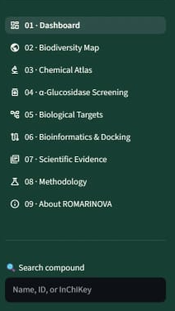


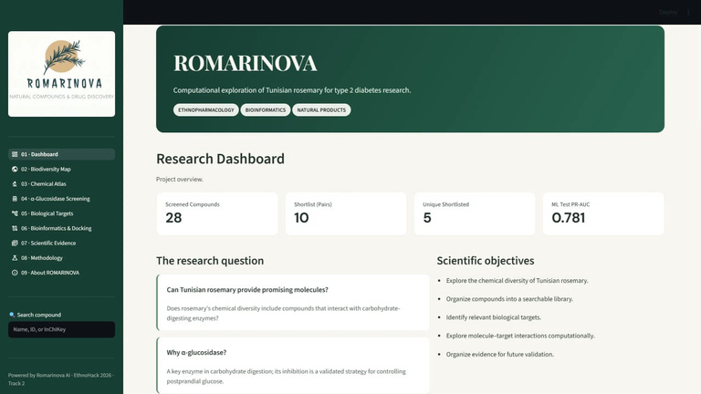
















From Computational Results to an Interactive Scientific Platform
ROMARINOVA is a Streamlit web application that turns computational insights into traceable, interactive discovery.
interactive scientific platform
ROMARINOVA
  3D Protein Viewer
  Rankings Comparison
  2D Structures
APPLICABILITY
DOMAIN
28/28
COMPOUNDS OUTSIDE DOMAIN
  Compound Information
use results with caution
  ML & Similarity Comparison
  Docking Visualization
  Diagnostics & Warnings
MORE THAN
PREDICTIONS
a traceability system from data sources to ranked candidates
  Candidate Traceability
  biodiversity map
FROM DATA TO DISCOVERY
BUILT-IN DIAGNOSTICS
transparent limitations,
clear warnings
SCIENTIFIC
DATABASES
COMPUTATIONAL
PIPELINE
CONSENSUS
RANKING
WEB
DASHBOARD
EXPLORE. COMPARE
UNDERSTAND
visualize proteins, compare methods, inspect structures, access evidence
Literature, chemical bioactivity, data
docking ML,
similarity analysis
Integrated scoring
and prioritization
Interactive exploration
and traceability
CURRENT LIMITATIONS (DIAGNOSTICS)
applicability domain extrapolation (28/28 compounds outside domain) | ECFM1 only fingerprint rigid receptor docking | no Molecular Dynamics yet

Slide 9

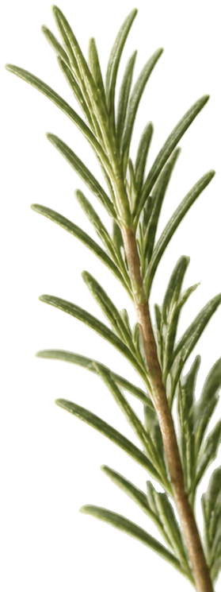







Responsible Innovation and
the Road Toward Experimental Validation
A transparent, reproducible path from computational discovery to real-world evidence
01
Computational
Screening
02
Experimental
Validation
03
Pharmaceutical
Research Perspectives
Prioritized monoterpene candidates
Alpha-glucosidase inhibition assays
Lead optimization
Integrated ML and docking workflow
ADMET and toxicity assessment
Mechanistic studies
Traceable chemical dataset
Molecular Dynamics studies
Formulation and delivery
Comparative ranking with
diagnostic transparency
Stronger training data and
appliquability domain validation
Path toward translational research
More Tunisian chemotypes
and geographic data
EVIDENCE KEPT SEPARATE
RESPONSIBLE INTERPRETATION
Computational predictions are not experimental evidence
Computational vs experimental evidence are kept distinct
No clinical efficacy claims are made
Results are contextual and hypothesis-generating
PAINS and ADMET flags are heuristic
Our pipeline is transparent, reproducible, and auditable

Slide 10








ROMARINOVA
From botanical diversity to molecular evidence
DIVERSE RESOURCE
INTEGRATED WORKFLOW
RELIABLE DISCOVERY
Tunisian rosemary is a chemically diverse
resource worth
systematic study
integrating literature
data, ML, similarity and
docking creates a
transparent prioritization
workflow
reliability requires identifying uncertainty, documenting
limitations and
validating predictions
experimentally
01
02
03
ROMARINOVA transforms fragmented scientific information into a traceable framework for natural-product drug discovery.
REFERENCES
ACKNOWLEDGEMENTS
Licenses & Attribution
ChEMBL: CC BY-SA 4.0
RDKit: BSD 3-Clause
AutoDock Vina: Apache 2.0
PDB: Public Domain
GBIF occurrence records: CC BY-NC 4.0 / CC BY 4.0 per record
EthnoHack 2026
Special thanks to the EthnoHack organizers
THANK YOU FOR YOUR ATTENTION

